Slide 1
The NYC Taxi CRISIS
Group 7
Haardik Sharma
Harsha Chandar
Yogesh Reddy

Slide 2
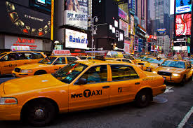
Agenda
BACKGROUND
DATA PROCESSING
TIPPING BEHAVIOR
NEXT STEPS

Slide 3
Background
The NYC Taxi industry is facing both driver and customer churn
Yellow taxis face fierce completion from Uber
Uber fleet outnumbers Yellow Taxis by 1.5x
Uber has about 25000 new users in NY signing up every week
Taxi owners are in financial crisis owing to large loans taken for buying medallions
They have started to look towards new initiatives to stay competitive
Two apps have been launched – Arro (10,000 downloads) and Way2Ride (4000)
Advantages of NYC Taxi over Uber:
Metered rates
Professional drivers
Regulated environment

Slide 4
Data PROCESSING
Data was a sample of the taxi records in Year 2013
Removed rows with missing lat/long values (1.8%)
Corrected rows where lat/long values were incorrectly swapped
Removed rows where travel time less than 30 seconds
Removed rows with passenger count 0
Added New columns:
Tip % - The amount of tip as a percentage of the Fare amount
Average Speed – Trip Distance in meters/Trip Time in Seconds

Slide 5
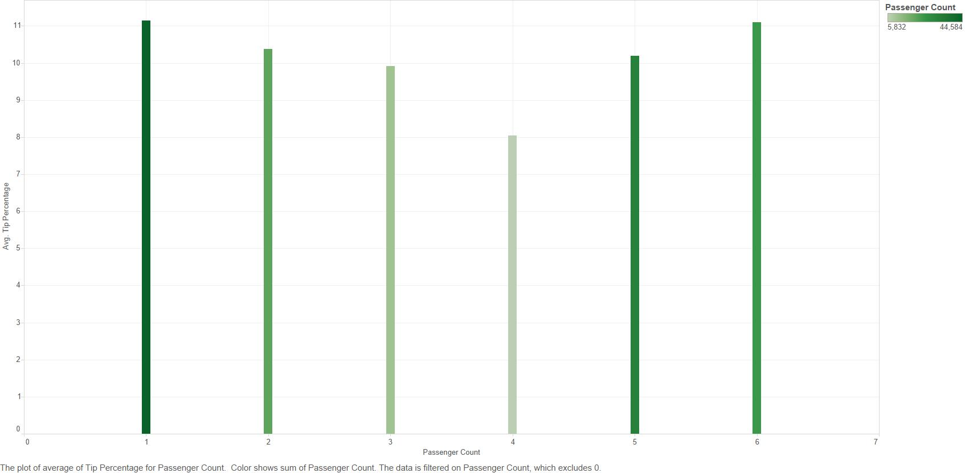
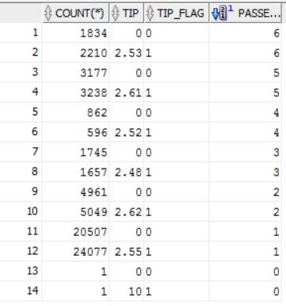
TIPPING BEHAVIOUR – Group Mentality
Tip Flag – 0 indicates no tip was given
Tip Flag – 1 indicates tip was given

Slide 6
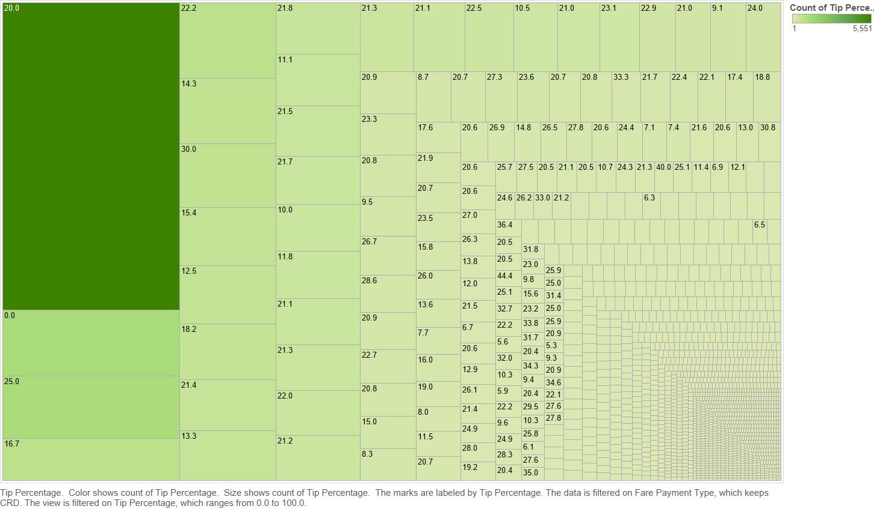
TIPPING BEHAVIOUR – Most common tip %

Slide 7
Next Steps
Further data exploration
Merge data with weather data
Reverse geocoding
Focus on other years' data
Compare competitor’s data

Slide 8
References
http://money.cnn.com/2015/07/21/news/companies/nyc-yellow-taxi-uber/
http://www.crainsnewyork.com/article/20150921/TECHNOLOGY/150919845/taxis-finally-try-to-beat-uber-at-its-own-game
http://www.huffingtonpost.com/2015/01/22/uber-drivers-pay-study_n_6527470.html

Slide 9
Questions?

